Slide 1
NASSAU DISTRICT SCHOOLS
EMPLOYEE BENEFITS
Notes:
Welcome to Nassau District Schools 2020-2021 Employee Benefits Presentation.

Slide 2
OPEN ENROLLMENT IS HERE!
July 31st
Notes:
Open Enrollment will begin on July 31, 2020 through August 28, 2020. Open Enrollment will allow you the opportunity to enroll in benefits or change your current elections for the next benefit year which starts on October 1, 2020 and runs through September 30, 2021. Open enrollment is your annual opportunity to enroll in a plan for the first time or make changes to the benefits you previously selected.

Slide 3
OPTIONS TO CONSIDER…
Notes:
During open enrollment, it is important for you to consider all of your options carefully before making any decisions. Because of COVID 19 we are limiting exposure by having presentations from Florida Blue, Humana, Teladoc, and other companies on our District website. The presentations are detailed and will help you to decide what options are best for you and your family. Once your elections have been made, you will be locked into those decisions for the duration of the benefit year, unless you experience a qualified life event. There are also links you can click on to review your ancillary options such as voluntary life and disability insurance, AFLAC, etc.

Slide 4
QUALIFIED LIFE EVENTS
When can I make a change to my benefits?
Notes:
A Qualified Life Event allows you to make changes to your benefits, outside of the open enrollment period. Examples of these types of events are marriage or divorce, birth or adoption of a child, you or a dependent child turning 26 years old and ageing off the plan or a change in employment status such as going from a part-time position to a full-time position. If you experience any of these types of events and choose to make changes to your benefits, you will need to notify the Human Resource Department within 30 days of the event date in order to qualify.

Slide 5
ALL CARRIERS ARE STAYING THE SAME!
Medical & Prescription
Dental & Vision
Disability and Life
Cancer, Critical Illness, Hospital & Accident
Life Insurance
Legal & ID Theft Protection
Notes:
For the 2020-2021 benefit year, all of the current insurance carriers will stay the same. Please note, for the 6th straight year in a row there is no increase to your Florida Blue health cost.

Slide 6
Dental Plan CS150 (HMO) is no longer available
Notes:
There is one dental option that will no longer be available for the 2020-2021 benefit year. The old platform DHMO-CS150 plan will be eliminated. Employees enrolled in the CS150 Dental Plan will be automatically transferred to the HS 205 plan. The HS 205 is a DHMO just like the CS 150, but it has more covered services. Please refer to your Insurance and Benefits Information Guide for rate information, depending on your enrollment tier. There is no need to complete a new application for the dental unless you are making a change such as adding or deleting a dependent or if you want to move to another plan (ADVANTAGE or PPO).

Slide 7
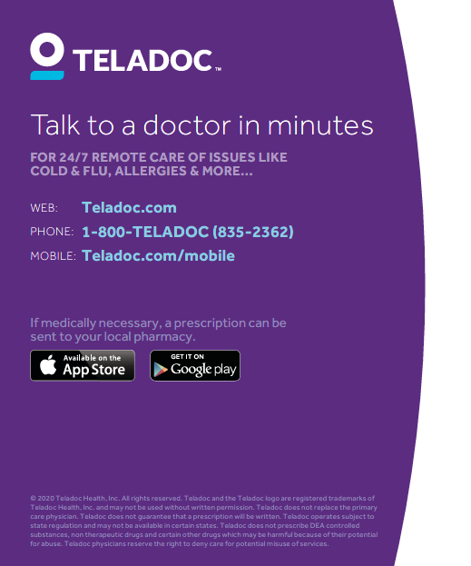
Telemedicine
Notes:
Please be sure to listen to the Teladoc presentation. This is a valuable benefit available to you for just a small copay at the time of service. This is a good time to enroll especially with the current COVID 19 challenges. By using Teladoc, for non-emergency services, it will allow you to speak to a doctor over your home phone, smart phone or computer rather than possibly being exposed by sitting in a physician’s office. The last slide on the Teladoc presentation will detail how you can enroll for this benefit.

Slide 8
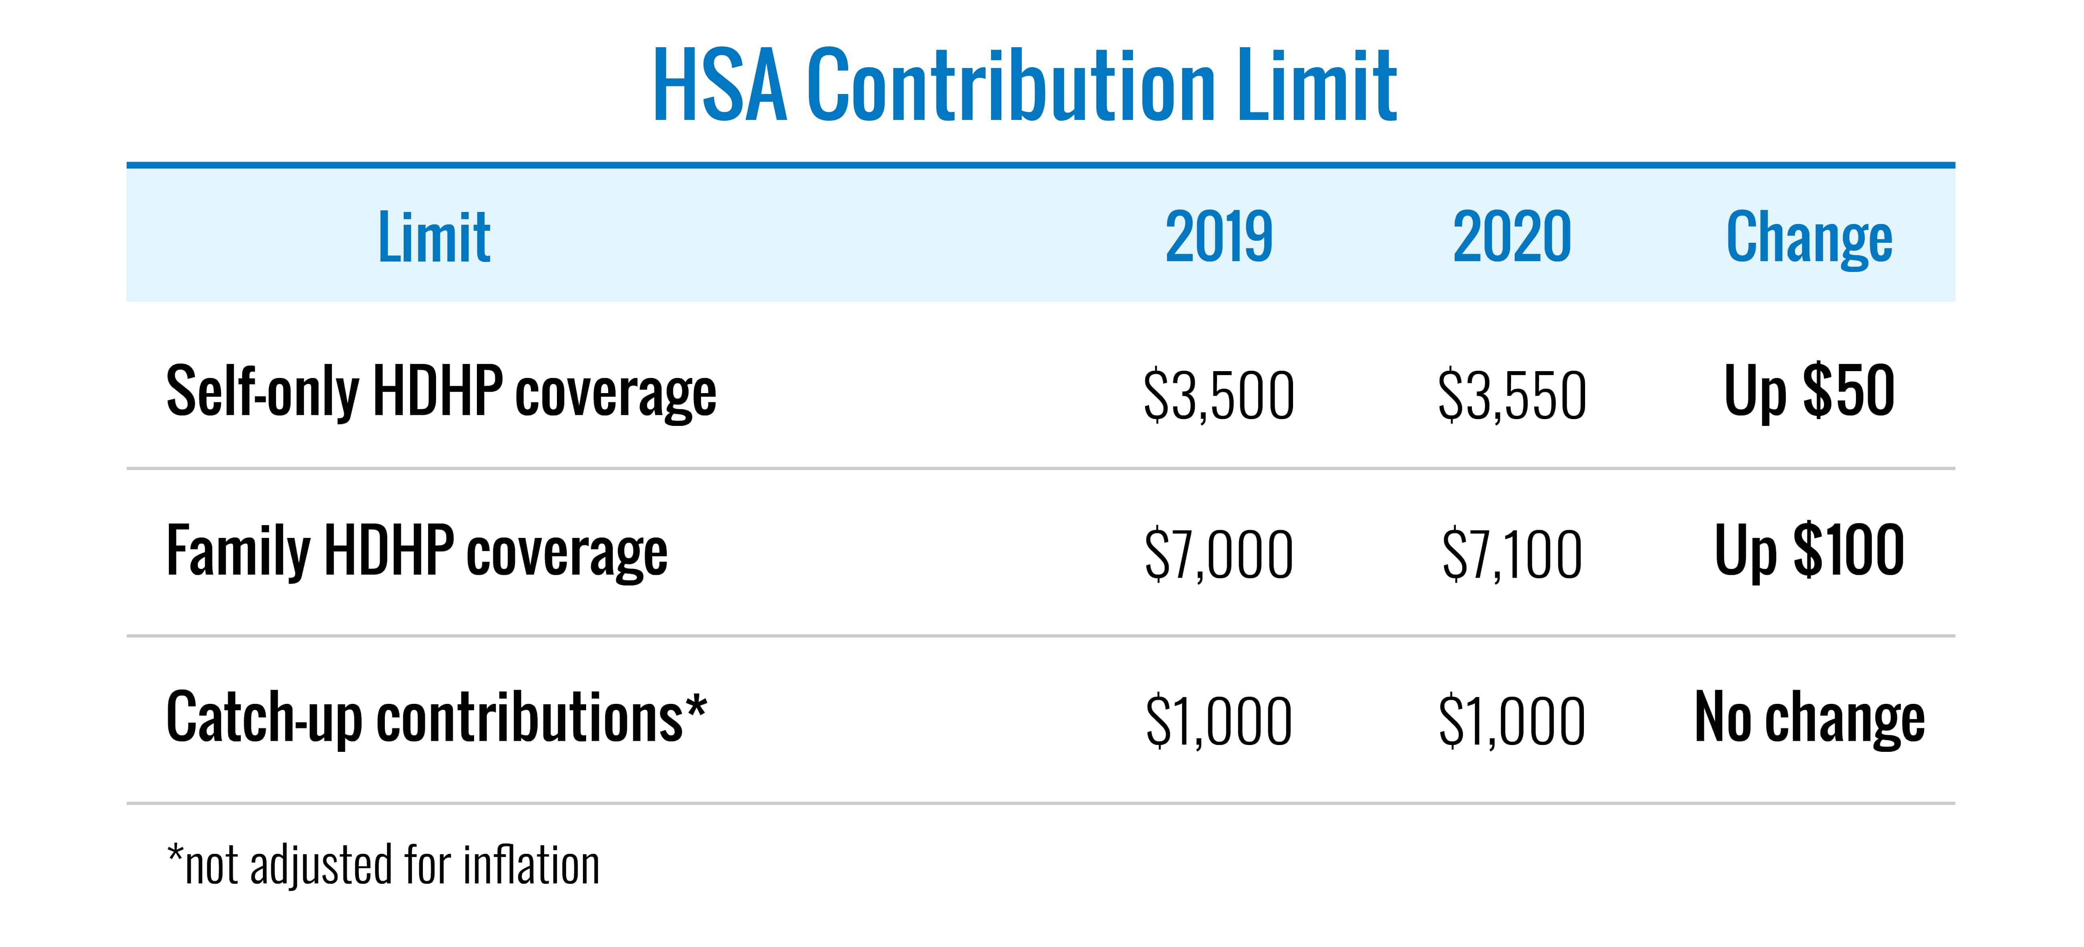
Notes:
The HSA Contribution limits have increased for employee only coverage on a High Deductible Health Plan from $3,500 to $3,550 and for family coverage on a High Deductible Health Plan from $7,000 to $7,100. There is no change to the catch-up contributions. Individuals are eligible for this extra contribution if they are 55 or turning 55 anytime during that year.

Slide 9
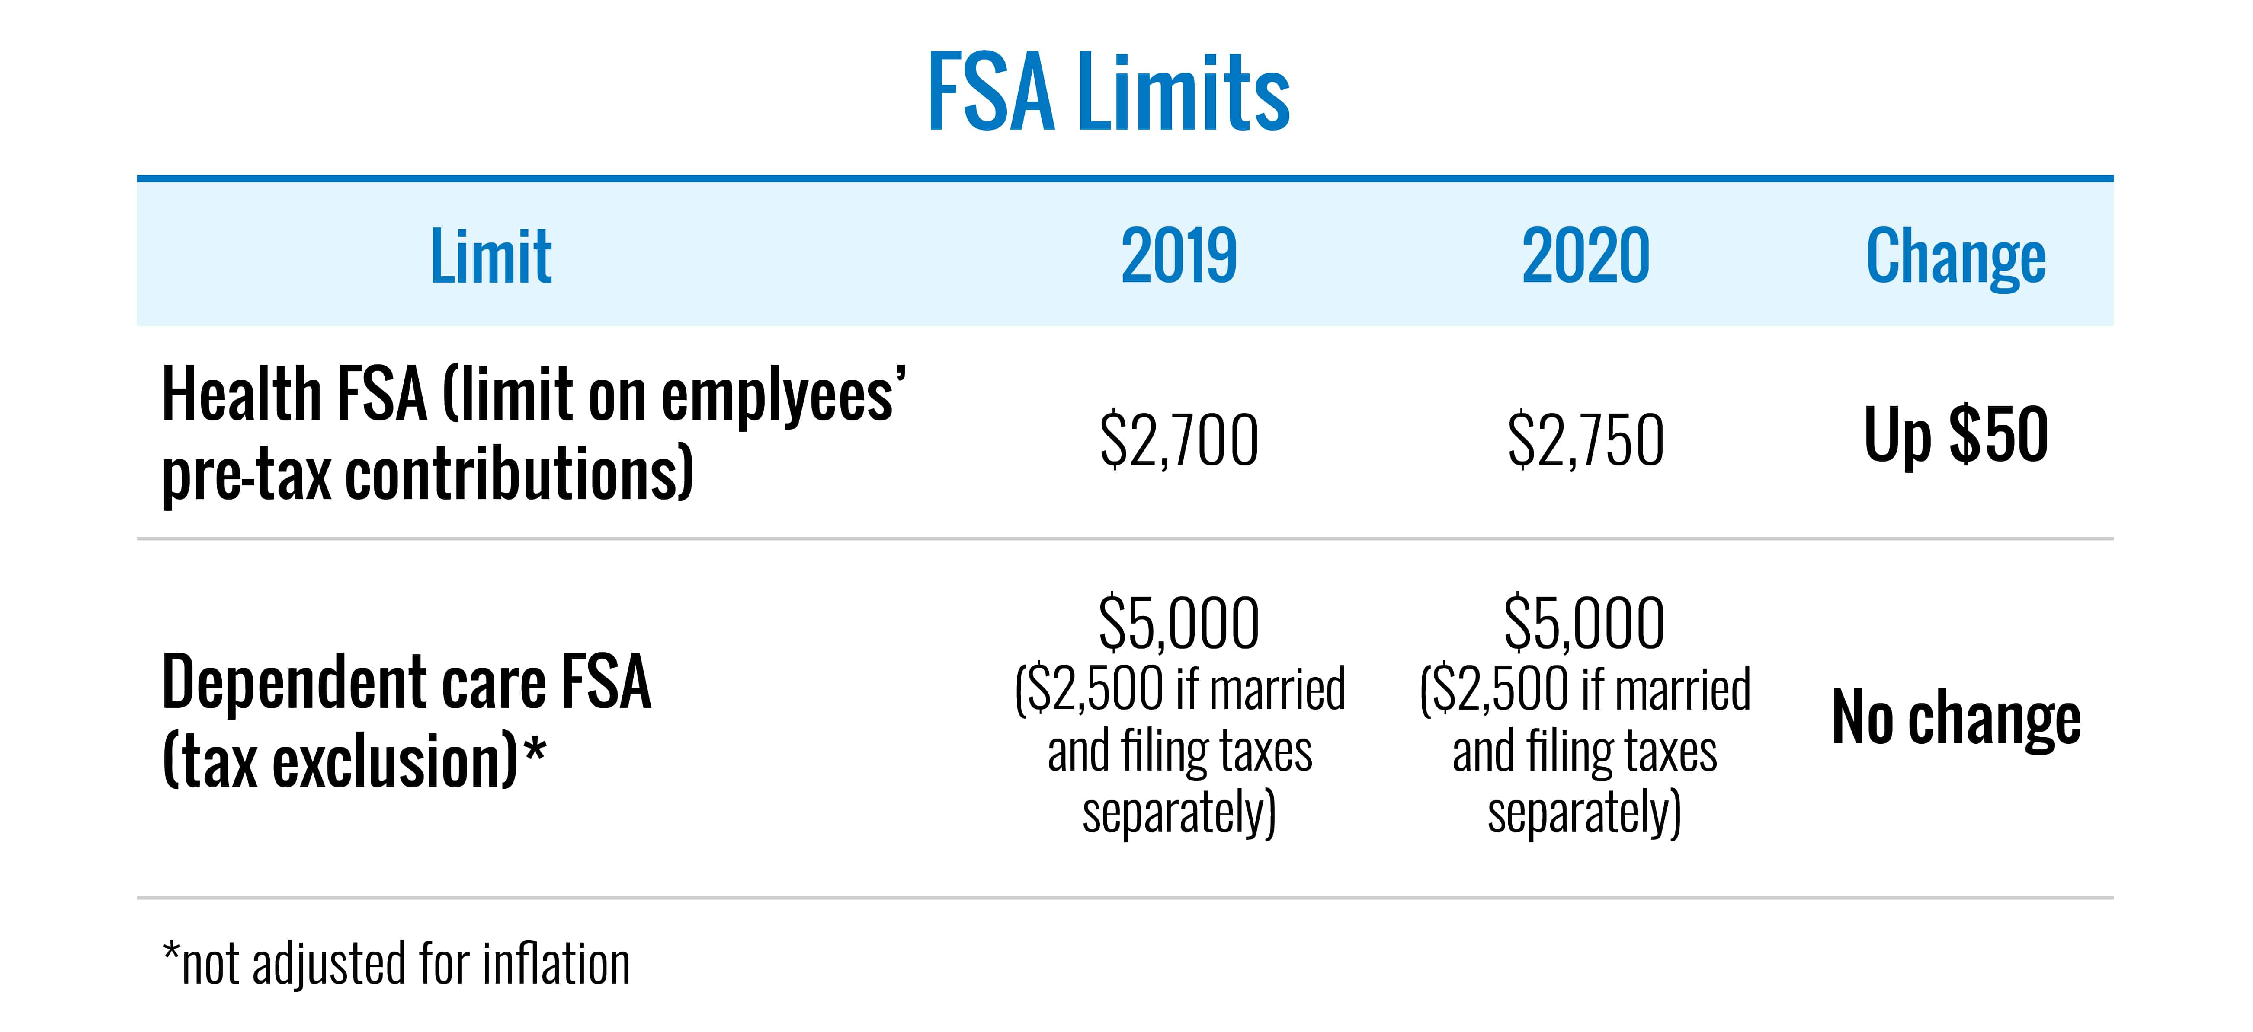
WHAT’S DIFFERENT THIS YEAR?
Notes:
The IRS has increased the allowable pre-tax contribution from $2,700 to $2,750 for the (Health) Flexible Spending Account (FSA). No changes have been made to the allowable amount for Dependent Care FSA. Flexible spending accounts allow you to have pre-tax payroll deductions for certain medical and dependent care expenses. Section 125 also permits your insurance premiums to be taken on a pre-tax basis. This provides tax savings to you.

Slide 10
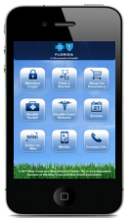
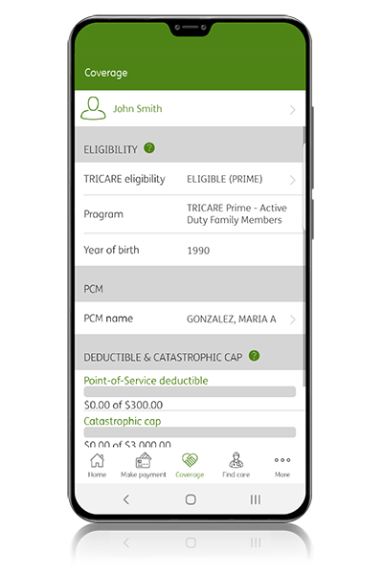
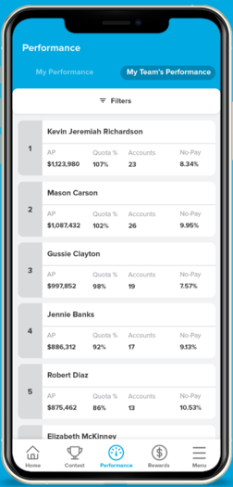
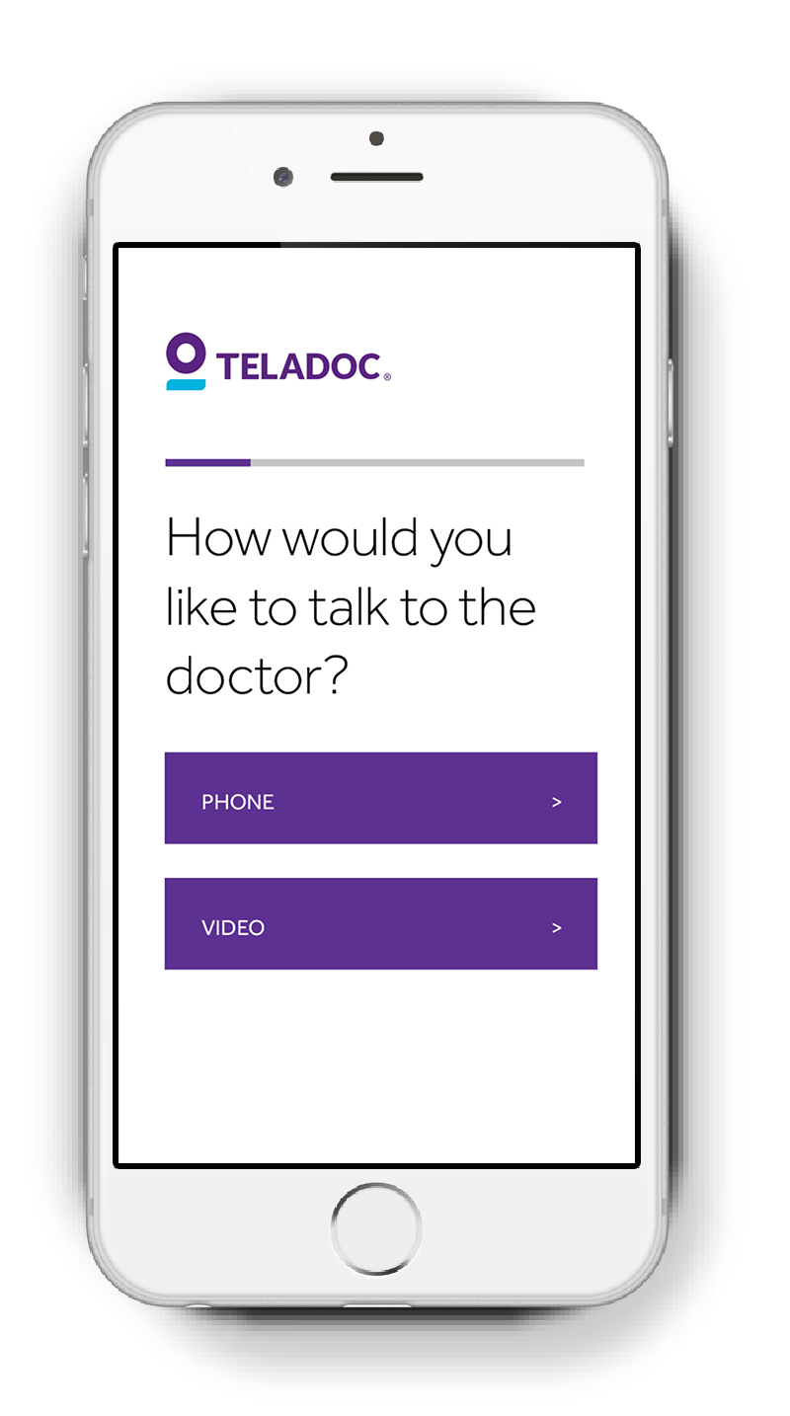
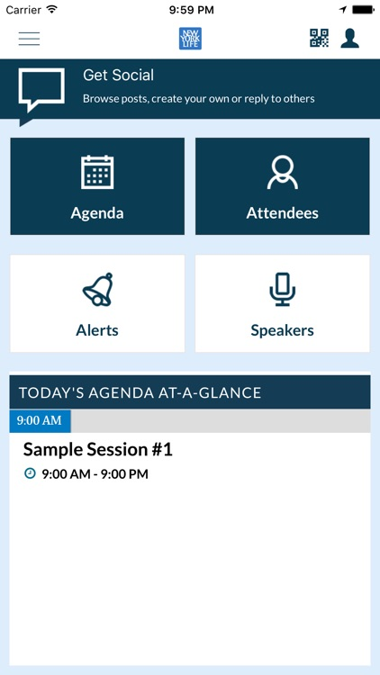
ONLINE TOOLS
Notes:
A number of your carriers have mobile assistance available to you. These online tools can assist you with locating an in-network provider, viewing claims status, checking coverage and some carriers even offer Digital ID cards for your convenience. These apps can be downloaded for free from your app store on your mobile device.

Slide 11
Employee Enrollment Form – Florida Blue
Notes:
If you are enrolling yourself and your family for the first time, you will have to complete an Employee Enrollment Application. Note that the word “Enrollment” is in the form for people enrolling for the first time.
The areas highlighted in yellow, are the areas the employees must answer. On the left, shows the details needed under Part B, employee details. Also, if you are choosing the HMO, part B is the place where a member would select their PCP. If left blank, Florida Blue will pick one for you! If you chose any of the PPO options, no need to place doctor name or ID number.
Section C requires you select the level of coverage (Employee Only, Spouse & Employee, Employee & Children, Family.) You must also select the network name, BlueOption or BlueCare, and the plan number.
On the right of your screen, we continue down page one, of the Florida Blue Enrollment form. Section E, is for dependent details. If you are not covering any dependents, please leave blank. You may also assign each dependent a separate PCP, if enrolling on any of the HMO options.
On page 2 of the document, Section F, is asking if members have any insurance coverage elsewhere. Section F, only requires your attention, if you have other health insurance coverage (private or public plan, Any part of Medicare). For members without secondary coverage, please answer No…. sing and date. Lastly, sign and date section G, Acceptance of Coverage, at the bottom of page 2.

Slide 12
Employee Change Application – Florida Blue
Notes:
Note that the word “Change” is in the form for people that have Florida Blue but decide to make plan changes for the new year. Examples of changes include: Adding, deleting dependents or changing plans, members will need to complete an Employee Change Application.
On your screen you will see the areas that need your attention highlighted in yellow. Page #1, Section A on the left of your screen, requires a member’s name, social security number, and change effective date. Section B requires the reason for change. For the discussion at hand, open enrollment should be the option used. Part B also has the section to select your PCP (For HMO only). Member can change their plan, coverage level (employee, employee + spouse, employee + children, Family coverage) or make dependent changes (add, delete dependents).
Continuing down page 1 on the right, section C, is for dependent information. At the end of the page, you will find the other insurance coverage section, part D. Answer yes or no to other coverage, sign and date. Please share the details of your other coverage, if you answered yes to this question.
On page 2 of the change form, not seen on your screen, members need to only sign and date part E, Change Authorization, to complete the form.

Slide 13
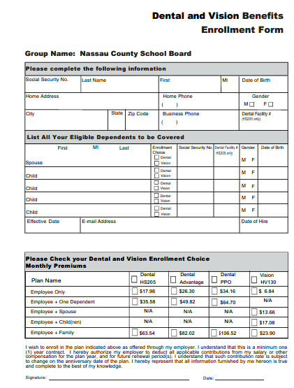
Employee Enrollment Form –Humana
Notes:
If you are enrolling yourself and your family in dental or vision for the first time, you will have to complete an Employee Enrollment Application. Note that the word “Enrollment” is in the form for people enrolling for the first time.
You must complete all three sections. The first section includes employee details. Also, if you are choosing the DMO, in this section you will include the dental facility number. If left blank, Humana will pick one for you! If you chose the Dental Advantage or PPO options, no need to place doctor name or ID number.
The middle section of the form is for dependent details. If you are not covering any dependents, please leave blank.
The final section requires you select the level of coverage (Employee Only, Spouse & Employee, Employee & Children, Family) and the appropriate plan. Please don’t forget to complete the form with your signature at the bottom.

Slide 14
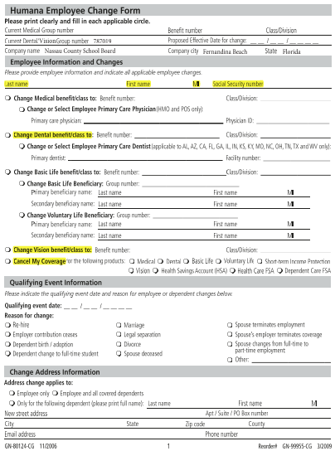
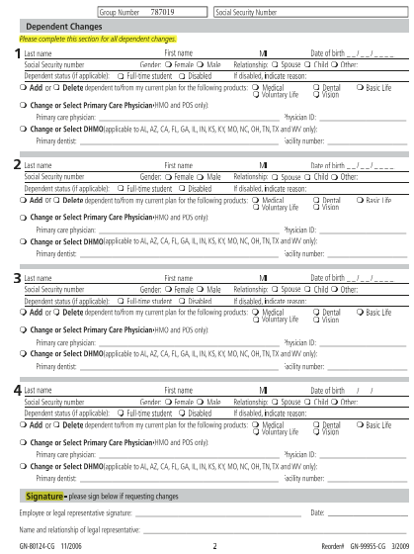
Employee Change Form –Humana
Notes:
Note that the word “Change” is in the form for people that have Humana but decide to make plan changes for the new year. Examples of changes include: Adding, deleting dependents or changing plans, members will need to complete an Employee Change Form.
On your screen you will see the areas that need your attention highlighted in yellow. Page #1, on the left of your screen, requires a member’s name, social security number, and benefit plan number, either dental or vision. There is a separate box for canceling your coverage.
Page 2 of the change form is for dependent information. If you are adding or deleting dependents, you will indicate on this page. At the end of the page, after you add or delete dependents as needed, please sign and date.

Slide 15
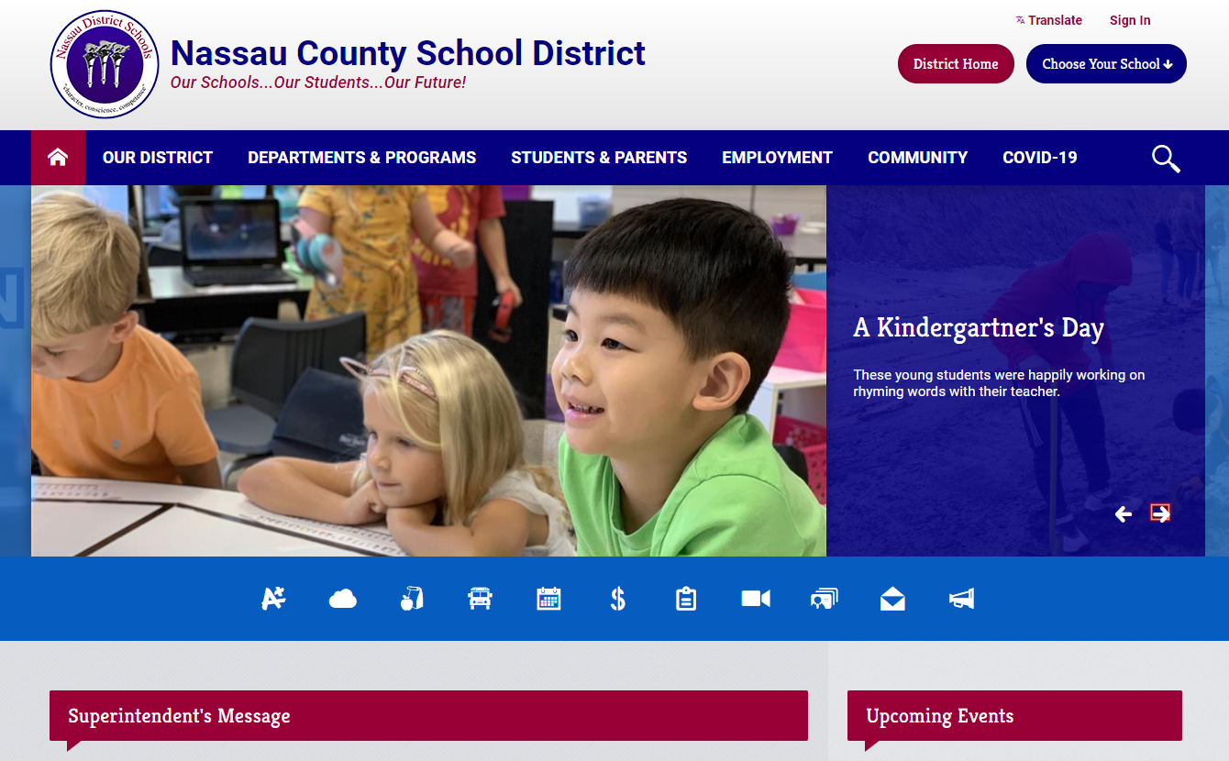
DISTRICT WEBSITE PROVIDES VALUABLE RESOURCES
WWW.NASSAU.K12.FL.US/HR
Notes:
If you have not already done so, please take some time and visit the District’s Human Resource Department website for many valuable resources, such as Human Resources Department contacts including areas of responsibility, benefits & insurance, personnel documents, NTA and NESPA Contracts, evaluation plans, leave information, etc.

Slide 16
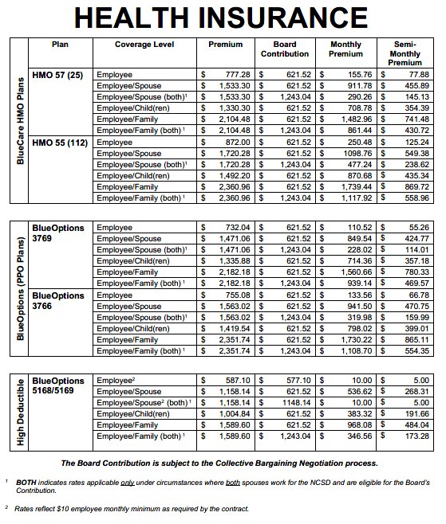
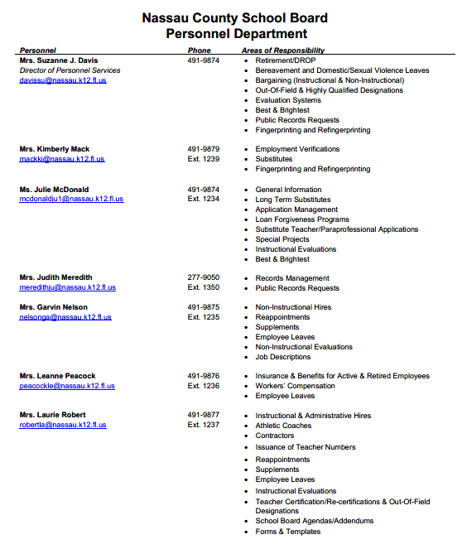
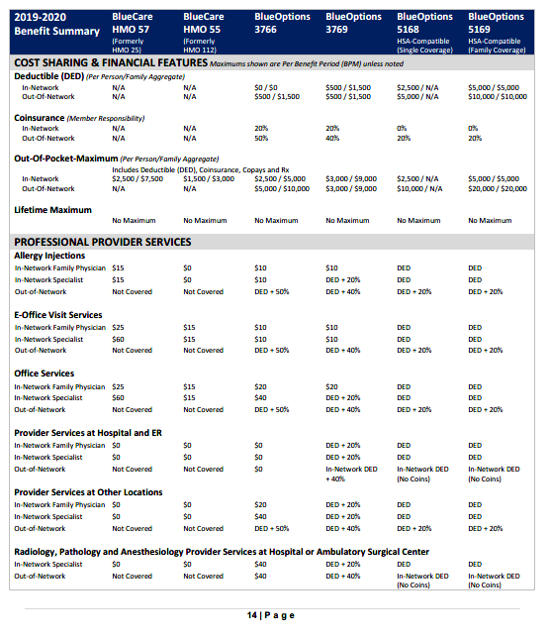
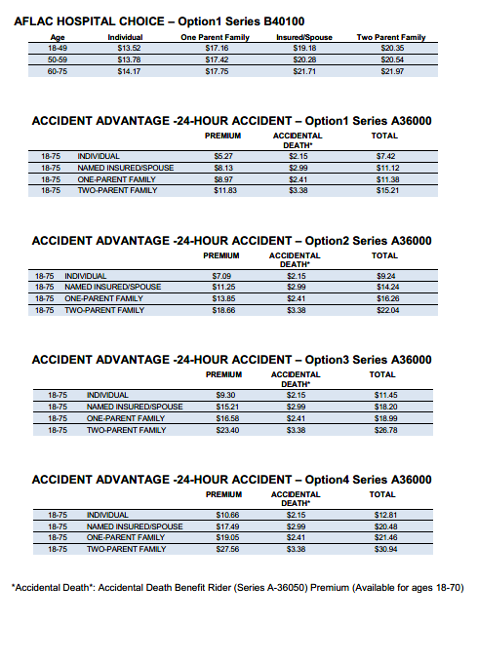
QUESTIONS?
PLEASE REFER TO YOUR 2020-2021 INSURANCE & BENEFITS INFORMATION GUIDE
Leanne Peacock - (904) 491-9876
Notes:
If you have questions that were not addressed in the presentation today, please refer to your 2020-2021 Insurance Benefits Information Guide. Always remember that we are here to help; specific contact information can be found on the back of your guide or feel free to call Leanne Peacock at 904-491-9876.

